Slide 1
GLOBAL TOURISM INVESTORS’ SUMMIT 2023 ROAD SHOW 12 January 2023; Kolkata
Department of Tourism
Government of West Bengal

Slide 2
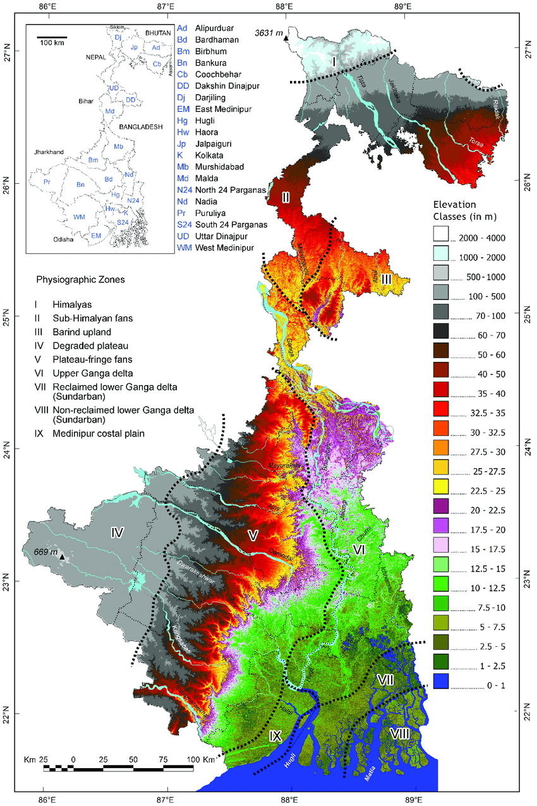
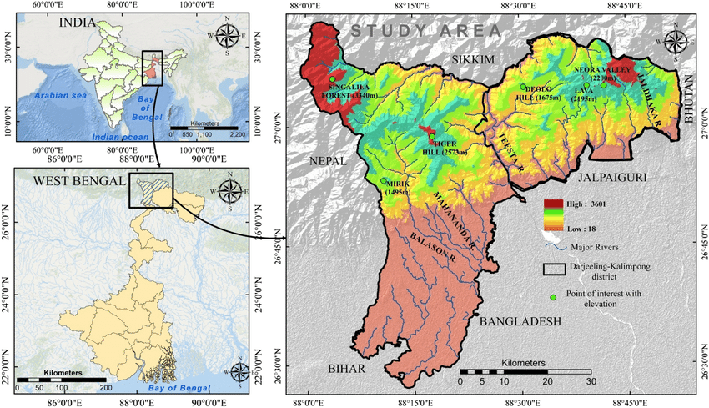
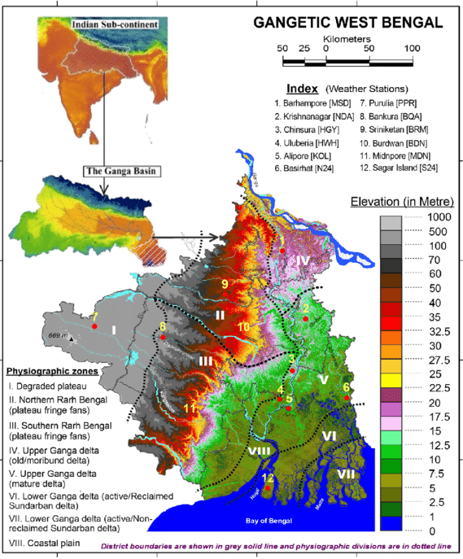
West Bengal – The Mini India
Gangetic Plains in the South &
Sub-Himalayan and Himalayan area in the North

Slide 3
West Bengal – The Mini India
Unique features
UNESCO World Heritage - Sunderbans delta, Toy Train
Tea plantations
Wetlands
Sea and beaches
Dooars
Mountains
Wildlife
Rivers
Forests
…….and what not
These all give the State a huge competitive advantage

Slide 4
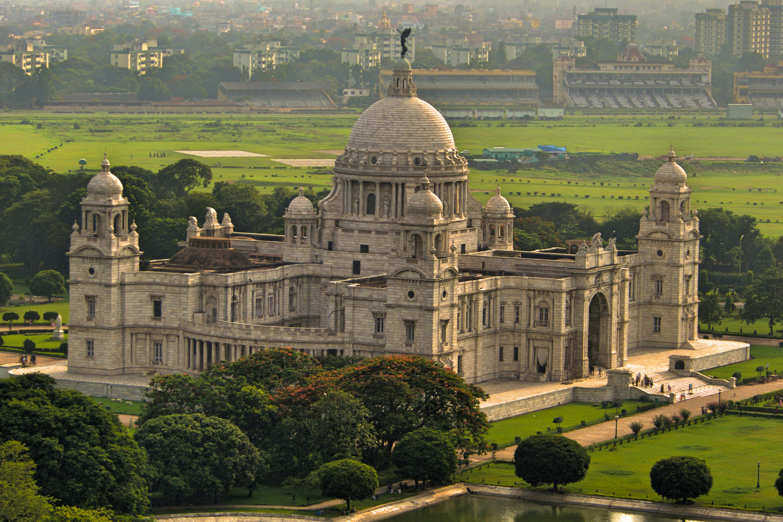
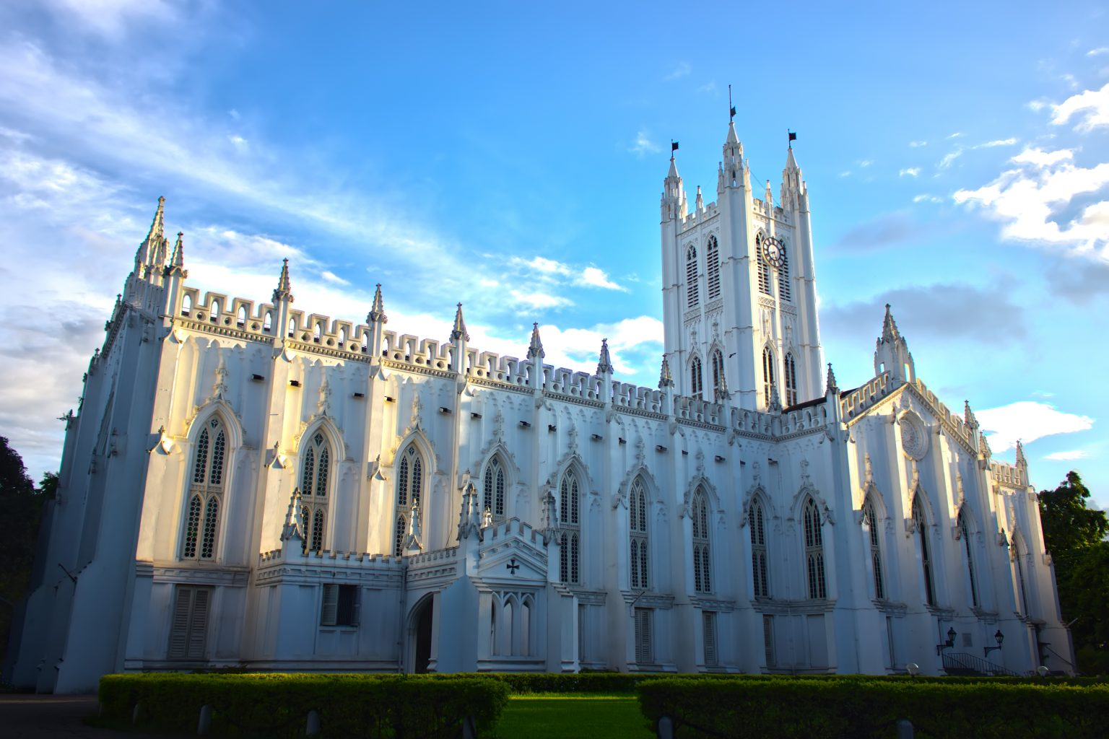
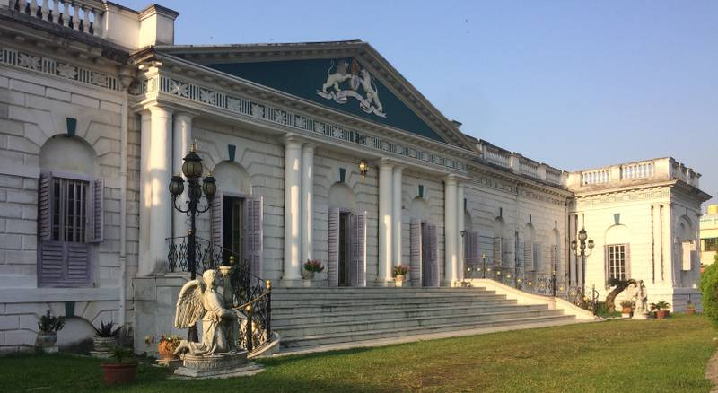
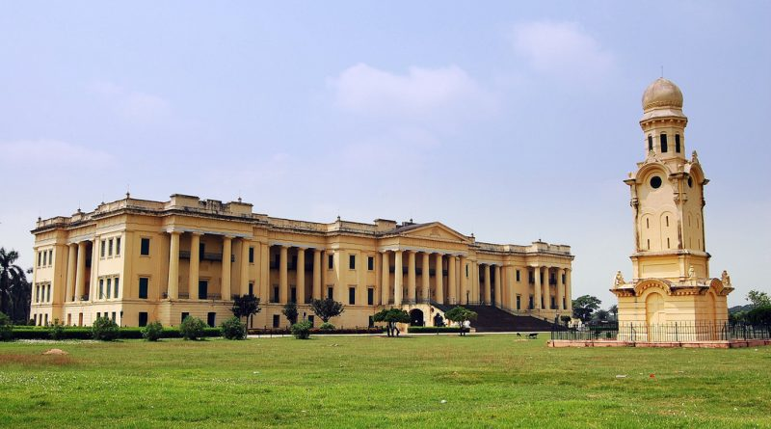
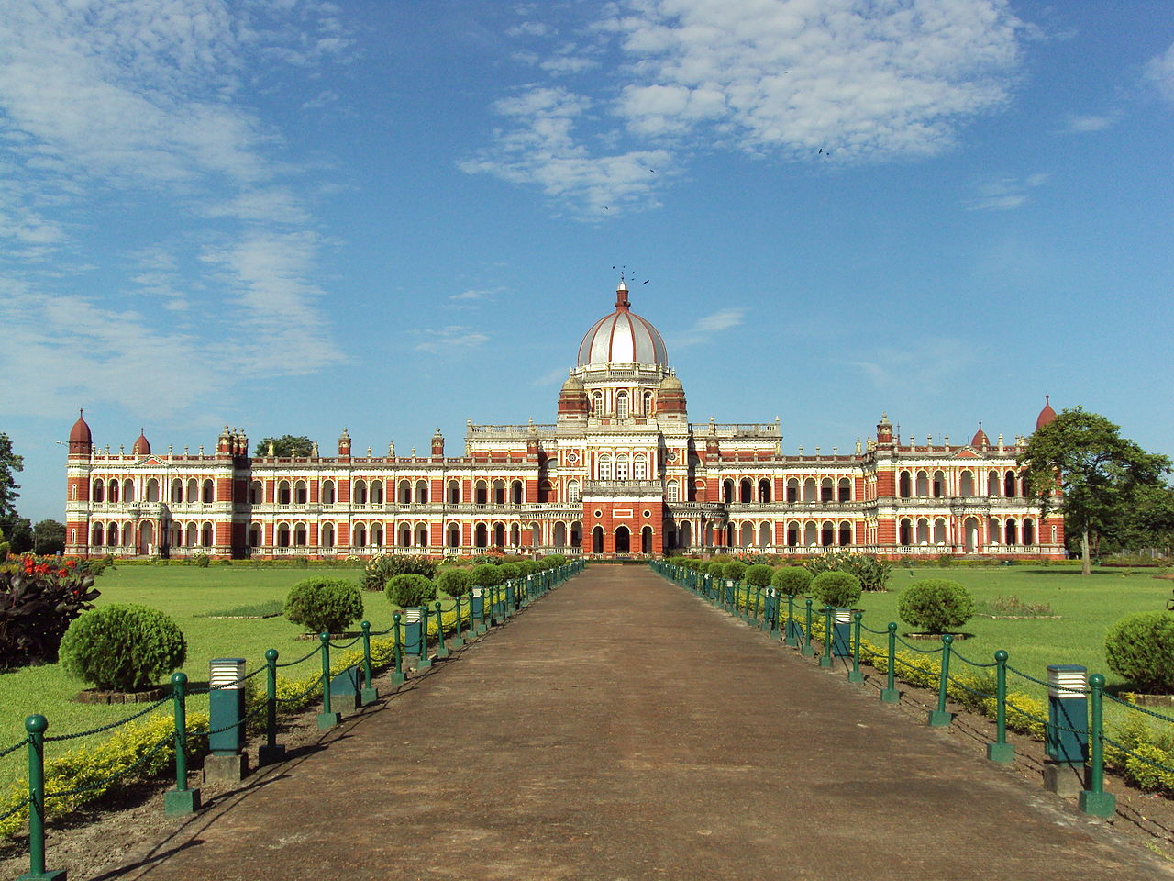
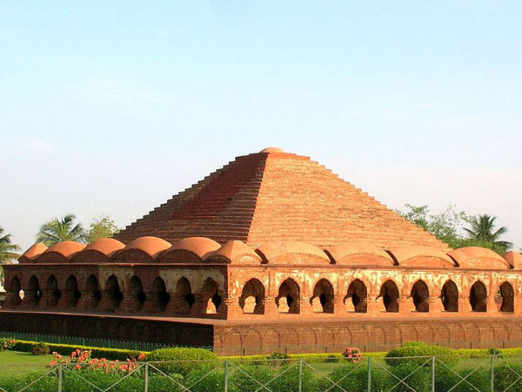
West Bengal
Architectural Heritage

Slide 5
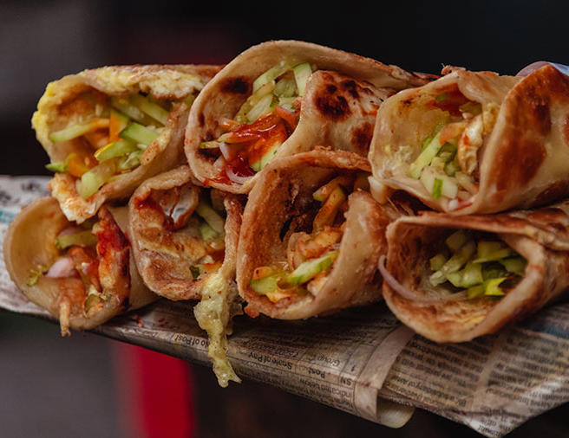
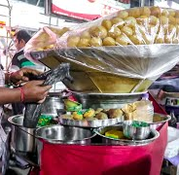
West Bengal
Cuisines, sweets and street food

Slide 6
West Bengal
Vital Role of Tourism in state’s economy
12 % contribution to West Bengal GDP including spillovers to other sectors (national average - 9.6%)
The State Government is keen to strengthen the sector which is likely to have a spillover effect of
Creating livelihood opportunities &
Boosting the local economy
Each district has its own unique tourism resource
Immense potential to utilize with the help of private sector
West Bengal is ranked 5th in terms of the Foreign Tourist Arrivals (FTAs) as per last year’s India Tourism Statistics
This is bound to grow phenomenally with direct flight connections with Europe and the USA – opportunities to work together

Slide 7
West Bengal
Important policies framed for a focused approach to various sub-sectors of Tourism and facilitate the Ease of Doing Business
West Bengal Tourism Policy 2019
Tea Tourism Policy 2019
West Bengal Homestay Tourism Policy 2017 amended in 2019
Recognition of Tourism Services Providers, 2021
West Bengal Tourist Guides Certification Scheme 2021
Revised Incentive Policy for the Tourism Industry, 2021

Slide 8
West Bengal
Some Additional Policies that are currently in pipeline:
Draft – WB Eco Tourism Policy
Draft – Adventure Tourism Policy
Draft – Heritage Tourism Policy
Draft – Rural Tourism Policy
Draft – PPP Policy
Draft – Caravan Tourism Policy
Draft – River Cruise Tourism Policy
Draft – Health & Wellness Tourism Policy

Slide 9
West Bengal
Tourism opportunities that could establish significant linkages with Private Investors and the G-20 nations
Cruise Outsourcing
City Based Tourism
Integrated City Pass
Hop on Hop off Tourist Bus Service
Private investments in Heritage Walking Tours & Stays, Heritage Cruises, Culinary Tourist Walks and Tourist Bus Services
Medical and Wellness Tourism
Incentive Scheme

Slide 10
West Bengal
Tourism opportunities that could establish significant linkages with Private Investors and the G-20 nations
Quantum of Project Investment in West Bengal
Quantum of Private Investment
Tourist Guides
Home Stay
Industry Status to Tourism in West Bengal
Intangible Cultural Heritage
Tangible Cultural Heritage
Religious Tourism
The Durga Puja in Kolkata has recently been inscribed in UNESCO’s Representative List of the Intangible Cultural Heritage of Humanity

Slide 11
West Bengal
Tourism opportunities that could establish significant linkages with Private Investors and the G-20 nations
Tea Tourism
Art & Craft Villages
Eco Tourism
Souvenir Outlets
Heritage Villas & Home Stays for Accommodation
Ropeways

Slide 12
West Bengal
Tourism in West Bengal would reach greater heights with your support…
Thank You

